Slide 1
Relational Database Pacmann – Mobil Bekas
Kyrie Cettyara Eleison Sept 2023

Slide 2
Agenda
Latar Belakang
Design Database
Transactional Query
Analytical Query

Slide 3
Latar Belakang
Membangun pemahaman dan pengaplikasian data dalam membangun sebuah sistem. Dalam project ini kita diminta untuk membangun relational database untuk sebuah website yang menawarkan penjualan mobil bekas.
Project ini dibuat untuk memenuhi nilai kelulusan course “Relational Database (SQL)”

Slide 4
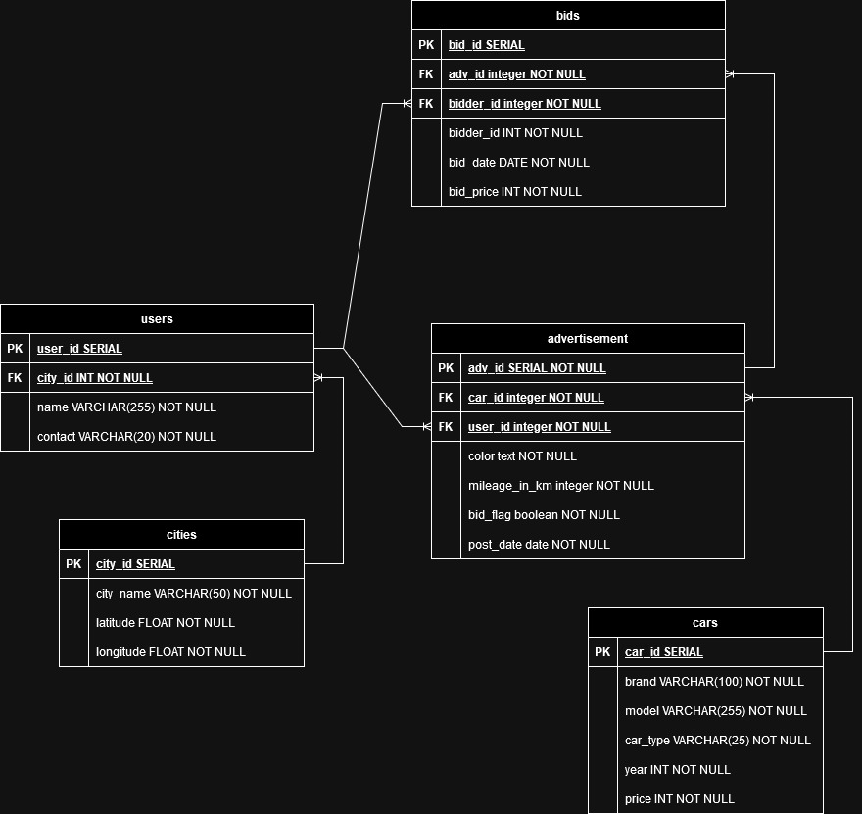
Design Database
Notes:
Mengerti dan dapat menggunakan basic dari bahasa pemrograman python. Seperti variabel looping dan brancing.
Mengerti dan dapat menggunakan SQL sederhana. Untuk Project ini tidak menggunakan banyak function yang ada di SQL. Untuk project ini SQL yayng digunakan adalah melakukan create table dan insert data to table.
Sqlalchemy yaitu sebuah toolkit yang dapat kita gunakan agar python dapat berkomunikasi dengan database. Seperti melakukan create table dan insert data to table.
Prettytable digunakan untuk menampilkan data didalam list kedalam bentukk tabular yang lebih rapih dipandang untuk mata.

Slide 5
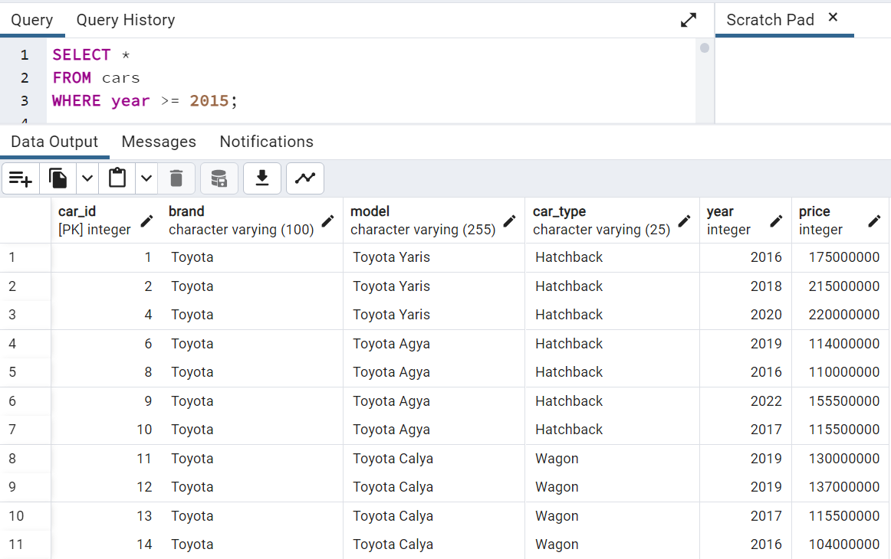
Transactional Query 1

Slide 6
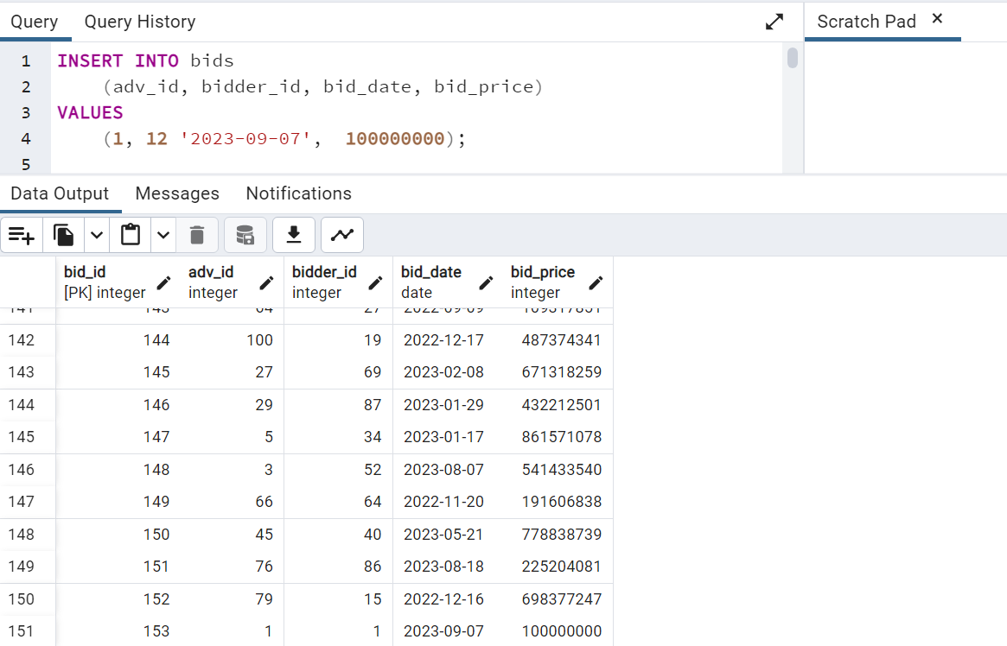
Transactional Query 2

Slide 7
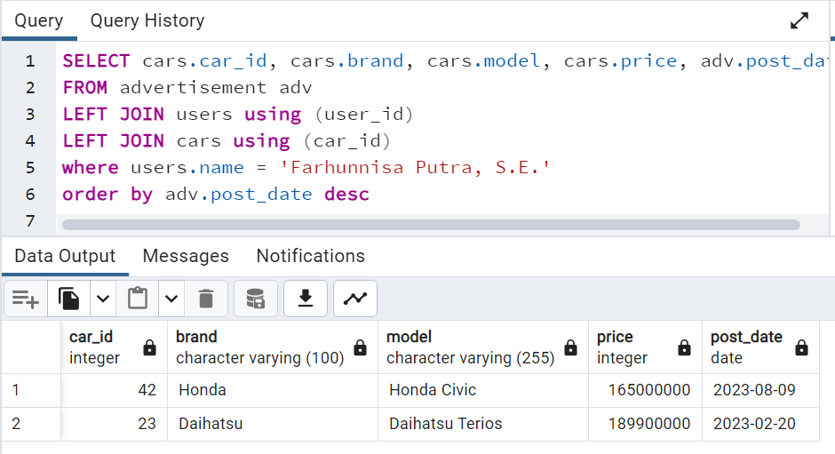
Transactional Query 3

Slide 8
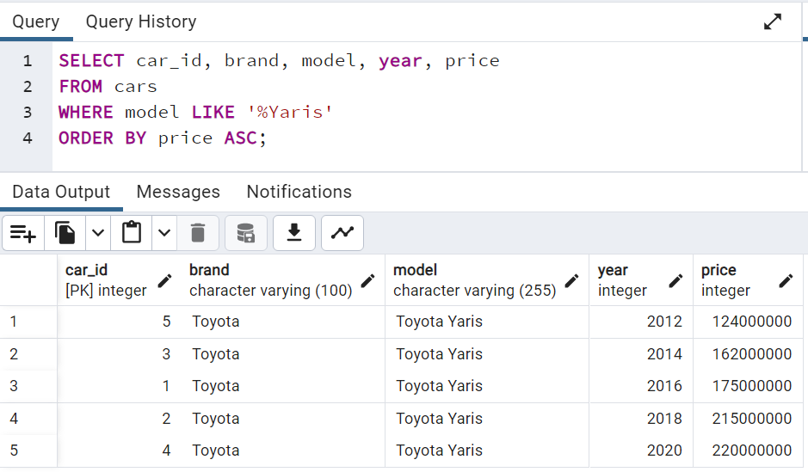
Transactional Query 4

Slide 9
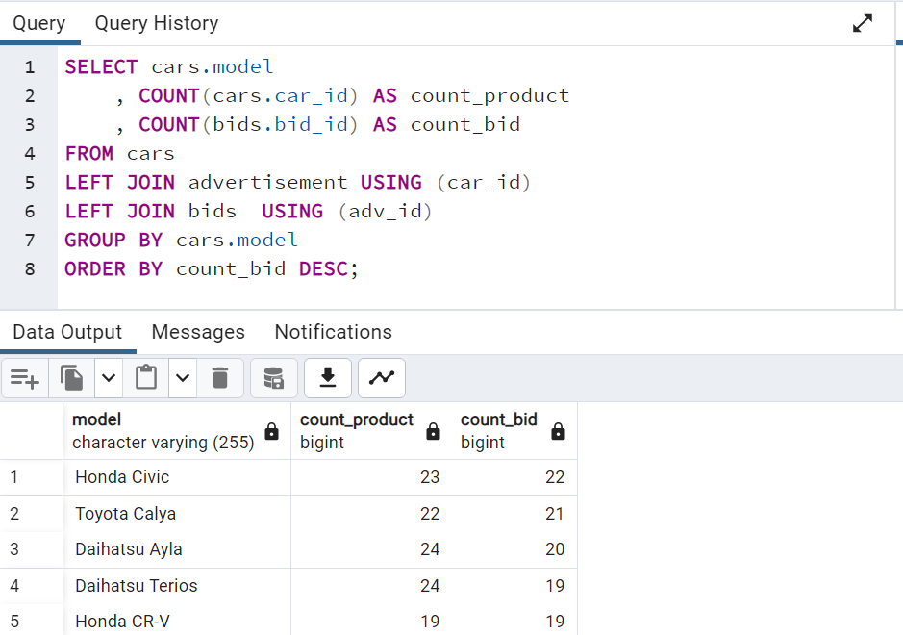
Analytical Query 1

Slide 10
Analytical Query 2
WITH avg_per_city as
(
SELECT cities.city_id
, AVG(cars.price) AS avg_price
FROM users
JOIN advertisement adv USING (user_id)
JOIN cities USING (city_id)
JOIN cars ON adv.car_id = cars.car_id
GROUP BY cities.city_id
)
SELECT cities.city_name
, cars.brand
, cars.model
, cars.year
, cars.price
, apc.avg_price
FROM users
JOIN advertisement adv USING (user_id)
JOIN cities USING (city_id)
JOIN cars ON adv.car_id = cars.car_id
JOIN avg_per_city apc USING (city_id)

Slide 11
Analytical Query 3
CREATE OR REPLACE VIEW cars_bids AS
SELECT
cars.model
, bids.bidder_id
, bids.bid_date
, bid_price
FROM cars
JOIN advertisement adv USING (car_id)
JOIN bids ON adv.adv_id = bids.adv_id
WHERE cars.model LIKE 'Toyota Yaris'
ORDER BY user_id
, bid_date ASC;
SELECT model
, bidder_id
, bid_date
, bid_price
, LEAD(bid_date) OVER (PARTITION BY bidder_id ORDER BY bid_date) as next_bid_date
, LEAD(bid_price) OVER (PARTITION BY bidder_id ORDER BY bid_date) as next_bid_price_idr
FROM yaris_bids
ORDER BY yaris_bids.user_id ASC, bid_date ASC;

Slide 12
Analytical Query 4
WITH model_bid_int_6m AS
(
SELECT cars.model
, bids.bid_price
, bids.bid_date
FROM bids
LEFT JOIN advertisement USING (adv_id)
LEFT JOIN cars USING (car_id)
WHERE bid_date >= NOW() - INTERVAL '6 months'
)
SELECT cars.model
, AVG(bids.bid_price) AS avg_price
, AVG(avg_bid.bid_price) AS avg_bid_6month
, AVG(bids.bid_price) - AVG(avg_bid.bid_price) AS difference
, ((AVG(bids.bid_price) - AVG(avg_bid.bid_price))/ AVG(bids.bid_price))*100 AS difference_percent
FROM bids
LEFT JOIN advertisement USING (adv_id)
LEFT JOIN cars USING (car_id)
LEFT JOIN model_bid_int_6m avg_bid ON avg_bid.model = cars.model
GROUP BY cars.model;

Slide 13
Thank You

